Slide 1
Building Software on Piz Daint
User Lab Day 2018
Luca Marsella, CSCS
September 11th 2018

Slide 2

Outline of the Presentation
Piz Daint Cray XC50 / XC40
Features of the hybrid system
Operating System CLE 6.0 UP04
NVIDIA CUDA Toolkit
Developers zone
Documentation
Cray Programming Environment
Cray PE August 2017
Static vs. dynamic linking
Easybuild Framework @ CSCS
CSCS office building in Lugano

Slide 3
Piz Daint Cray XC50 / XC40

Slide 4
System Specifications
Model | Cray XC50/XC40
XC50 Compute Nodes (Intel Haswell processor) | Intel® Xeon® E5-2690 v3 @ 2.60GHz (12 cores, 64GB RAM) and NVIDIA® Tesla® P100 16GB
XC40 Compute Nodes (Intel Broadwell processor) | Intel® Xeon® E5-2695 v4 @ 2.10GHz (18 cores, 64/128 GB RAM)
Login Nodes | Intel® Xeon® CPU E5-2650 v3 @ 2.30GHz (10 cores, 256 GB RAM)
Interconnect Configuration | Aries routing and communications ASIC, and Dragonfly network topology
Scratch capacity | Piz Daint scratch filesystem: 6.2 PB
File Systems
The $SCRATCH space /scratch/snx3000/$USER is connected via an Infiniband interconnect. The shared storage under /project and /store is available from the login nodes only!

Slide 5
Filesystems features
 | /scratch (Piz Daint) | /scratch (Clusters) | /users | /project | /store
Type | Lustre | GPFS | GPFS | GPFS | GPFS
Quota | Soft quota 1 M files | None | 10 GB/user 100K files | Maximum 50K files/TB | Maximum 50K files/TB
Expiration | 30 days | 30 days | None | End of the project | End of the contract
Data Backup | None | None | 90 days | 90 days | 90 days
Access Speed | Fast | Fast | Slow | Medium | Slow
Capacity | 6.2 PB | 1.4 PB | 86 TB | 5.7 PB | 4.4 PB
Soft quotas:
The $SCRATCH space /scratch/snx3000/$USER has a soft quota set to prevent any excessive load. Users exceeding the soft quota will be warned at submit time and will not be able to submit new jobs
Please build big software projects not fitting $HOME on $PROJECT instead, copying to $SCRATCH with the SLURM transfer queue xfer the executables, libraries and data sets needed to run your simulations

Slide 6
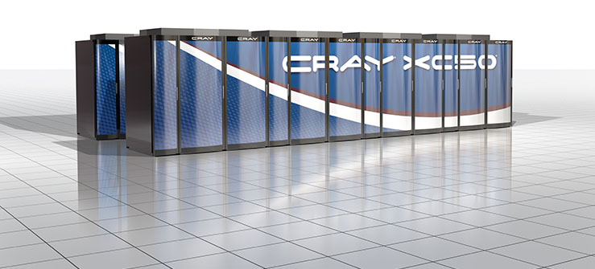
Cray Linux Environment 6.0 UP04
Cray Linux Environment (CLE) is the operating system on Cray systems
CLE 6.0 UP04 is based on the Novell SLES 12 SP2 base operating system
CLE 6.0 UP04 software release is available on the Cray XC50 Piz Daint
Read more on the Cray Pubs Portal: CLE 6.0 UP04 Software installation and configuration Guide (advanced)

Slide 7
Cray Documentation
Cray provides books and man pages that can be accessed in the following ways:
CrayPubs is the Cray documentation delivery system, enabling quick access and search of Cray books, man pages, and third-party documentation using HTML and PDF formats:
CrayPubs public website: http://pubs.cray.com
Man pages are textual help files available from the command line on Cray machines. To access man pages, enter the man command followed by the name of the man page. For more information about man pages, see the man(1) man page by entering “man man” on the shell

Slide 8
NVIDIA CUDA Toolkit

Slide 9

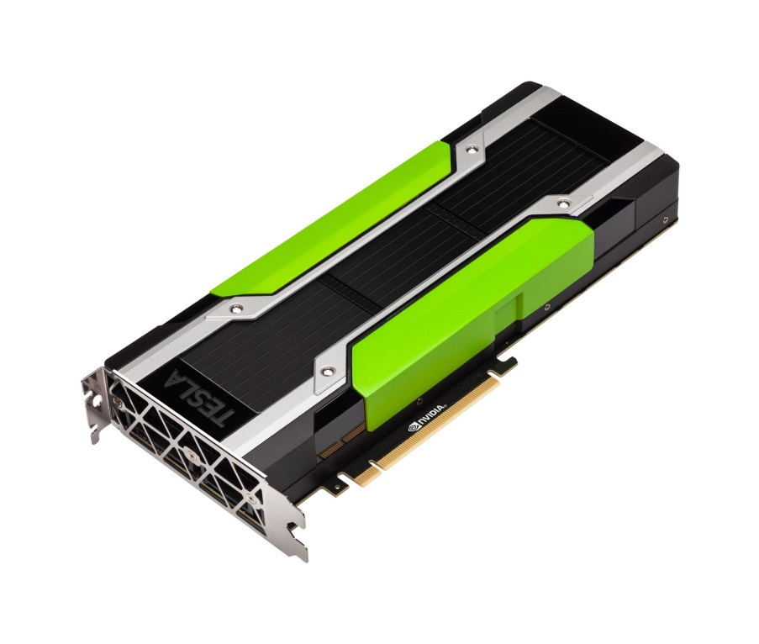
NVIDIA CUDA Toolkit v8.0
It features a comprehensive development environment to build GPU-accelerated applications
It includes compiler for NVIDIA GPUs, math libraries and tools for debugging and optimizing application performance
It provides programming guides, user manuals, API reference and online documentation to get started quickly
NVIDIA developer portal: https://developer.nvidia.com/cuda-zone
NVIDIA Tesla P100 GPU Accelerator

Slide 10
Features Highlights in CUDA Toolkit v8.0
General CUDA
you need to target the Tesla P100 architecture sm_60 with NVCC gpu architecture flags:
The module craype-accel-nvidia60 sets the environment to target builds on the Pascal GPU
adds support for GPUDirect Async, improving application throughput
CUDA Tools
CUDA compilers: Intel C++ Compilers 16.0 and 15.0.4 are now supported
CUDA profiler provides also CPU profiling to identify hot-spot regions in the code
CUDA Libraries
built-in for fp64 atomicAdd() that cannot be overridden with a custom user function
nvGRAPH, a library that is a collection of routines to process graph problems on GPUs
Features and release notes of CUDA Toolkit v8.0 and Pascal GPU Architecture
https://devblogs.nvidia.com/parallelforall/cuda-8-features-revealed
http://docs.nvidia.com/cuda/cuda-toolkit-release-notes
https://developer.nvidia.com/pascal

Slide 11
Documentation
NVIDIA Documentation Portal
http://docs.nvidia.com
CUDA Toolkit for Developers
https://developer.nvidia.com/cuda-toolkit
System located documentation
module help cudatoolkit
NVIDIA compiler
nvcc --help
CUDA debugger
cuda-gdb --help

Slide 12
Cray Programming Environment

Slide 13
The Cray Programming Environment on the hybrid Piz Daint
Released on a monthly basis, it uses the modules framework for library path management
The environment contains a set of libraries for each supported compiler (default: PrgEnv-cray):
The default target architecture is the Cray XC50 with Intel Haswell processors: craype-haswell
Users can change the target architecture by loading one of the following modules:
daint-gpu it targets the XC50 architecture (Intel Haswell and P100 Tesla GPUS)
daint-mc it targets the XC40 architecture (Intel Broadwell multicore)
The modules above will update the MODULEPATH: use the module switch command to change environment!

Slide 14
Cray XC Programming Environment
The Cray XC PE 17.08 includes the Cray Developer Toolkit - CDT 17.08
non-default Programming Environments can be accessed using the Cray Development Toolkit (cdt) modules
The following products have been updated within this release:
Cray Compiling Environment - CCE 8.6.1
Cray Debugging Support Tools - CDST 17.08
lgdb 3.0.7
STAT 3.0.1.1
Cray Performance Measurement & Analysis Tools - CPMAT 6.5.1 (1)
Perftools 6.5.1
Cray Environment Setup and Compiling support - CENV 17.08
craype-installer 1.24.0
craype 2.5.12
Third party products
GCC 7.1.0
Third Party Licensed Products
Forge 7.0.5.1

Slide 15
Static vs Dynamic linking
Binaries can be linked statically and dynamically to the libraries on the system:
Cray compiler wrappers (cc, CC, ftn) create statically-linked executables by default
Dynamic linking: flag -dynamic or export CRAYPE_LINK_TYPE=dynamic before building
Note that dynamic linking becomes the default when the module cudatoolkit is loaded
Dynamically linked binaries can generally be used after a system library update
Statically linked binaries using directly or indirectly the network interface libraries (uGNI/DMAPP) instead must be recompiled after an update:
This includes applications using MPI or SHMEM libraries, as well as the PGAS (Partitioned Global Address Space) languages such as UPC, Fortran with Coarrays, and Chapel
DMAPP (Distributed Shared Memory Application) and uGNI (user Generic Network Interface) are tied to specific kernel versions and no backward or forward compatibility is provided

Slide 16
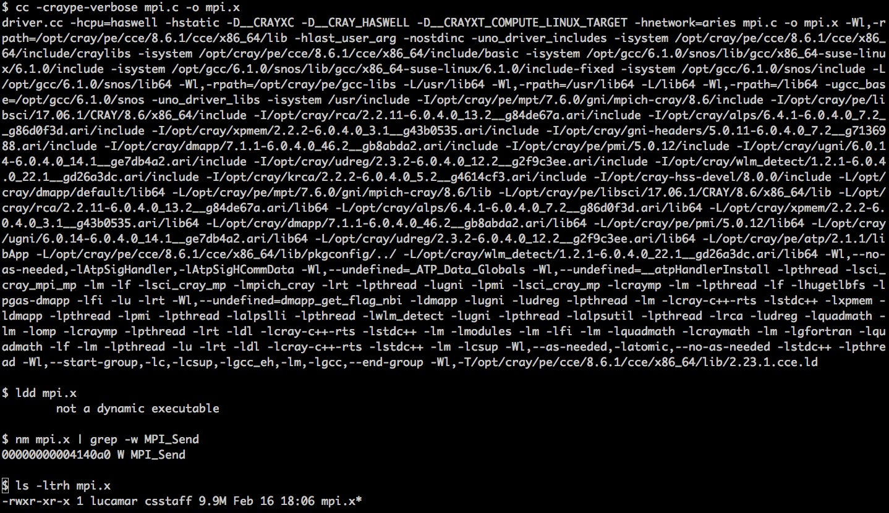
Static MPI executable using the compiler wrapper cc in PrgEnv-cray
Cray wrapper flags:
$ cc -help
In this example:
-craype-verbose
Prints the command sent to the compiler
No cuda module is loaded, hence the MPI library is linked statically (see size):
nm - list symbols from object files
E.g.: MPI function MPI_Send is listed

Slide 17
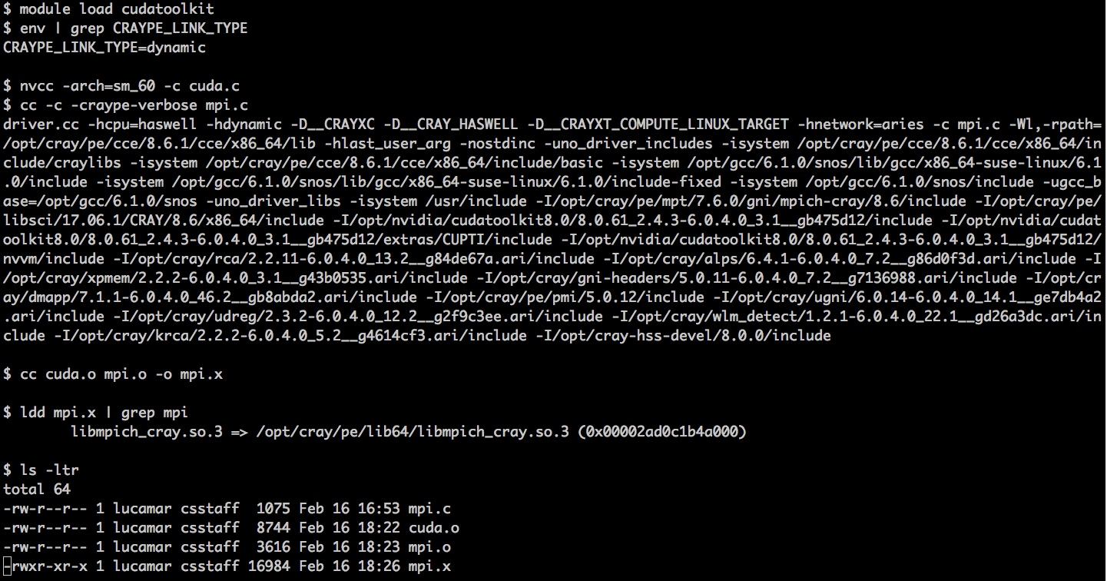
Dynamic MPI executable using the compiler wrapper cc in PrgEnv-cray
nvcc flags:
$ nvcc -h / --help
In this example:
-arch=sm_60
Targets the Tesla GPU P100 on the Cray XC50 system
When cudatoolkit module is loaded, CRAYPE_LINK_TYPE is defined dynamic:
ldd - print shared object dependencies
E.g.: libmpich_cray

Slide 18
Non-default Programming Environments with Cray Development Toolkit
Use the command module avail cdt to get the list of available cdt modules
Loading a non default cdt module while building or at runtime requires prepending CRAY_LD_LIBRARY_PATH to LD_LIBRARY_PATH
The environment variable CRAY_LD_LIBRARY_PATH holds every product library path in the current environment, updated when modules are loaded / unloaded
In the example below, we link dynamically the default NETCDF library provided by the module cray-netcdf in PrgEnv 16.11 (November 2016): cdt/16.11 brings cray-netcdf/4.4.1 as default, so we need to update the LD_LIBRARY_PATH
More information on https://user.cscs.ch/scientific_computing/code_compilation

Slide 19
Current default modules for compilers, libraries and tools
Compilers
cce/8.6.1
gcc/5.3.0
intel/17.0.4.196
pgi/17.5.0
Communication Libraries
cray-ga/5.3.0.7
cray-mpich/7.6.0
cray-shmem/7.6.0
Numerical Libraries
cray-libsci/17.06.1
cray-libsci_acc/17.03.1
cray-fftw/3.3.6.10
cray-tpsl/17.06.1
cray-trilinos/12.10.1.1
Performance tools
perftools/6.5.1
perftools-lite/6.5.1
papi/5.5.1.2
I/O Libraries
cray-hdf5/1.10.0.3
cray-netcdf/4.4.1.1.3
cray-hdf5-parallel/1.10.0.3
cray-netcdf-hdf5parallel/4.4.1.1.3
Debuggers
ddt/18.0.1
cray-lgdb/3.0.7
Pre- and Post-processing
cray-python/17.06.1
cray-R/3.3.3

Slide 20
Current default modules for main scientific applications and libraries
daint-gpu
Amber/16-CrayGNU-17.08-cuda-8.0
Boost/1.65.0-CrayGNU-17.08-python3
CDO/1.9.0-CrayGNU-17.08
CP2K/5.1-CrayGNU-17.08-cuda-8.0
CPMD/4.1-CrayIntel-17.08g
GROMACS/2018-CrayGNU-17.08-cuda-8.0
GSL/2.4-CrayGNU-17.08
LAMMPS/11Aug17-CrayGNU-17.08-cuda-8.0
magma/2.2.0-CrayGNU-17.08-cuda-8.0
NAMD/2.12-CrayIntel-17.08-cuda-8.0
NCL/6.4.0
NCO/4.6.8-CrayGNU-17.08
ParaView/5.4.1-CrayGNU-17.08-EGL
QuantumESPRESSO/6.1.0-CrayIntel-17.08
R/3.4.2-CrayGNU-17.08
VASP/5.4.4-CrayIntel-17.08-cuda-8.0
daint-mc
Amber/16-CrayGNU-17.08-parallel
Boost/1.65.0-CrayGNU-17.08-python3
CDO/1.9.0-CrayGNU-17.08
CP2K/5.1-CrayGNU-17.08
CPMD/4.1-CrayIntel-17.08g
GROMACS/2018-CrayGNU-17.08
GSL/2.4-CrayGNU-17.08
LAMMPS/11Aug17-CrayGNU-17.08
NAMD/2.12-CrayIntel-17.08
NCL/6.4.0
NCO/4.6.8-CrayGNU-17.08
QuantumESPRESSO/6.1.0-CrayIntel-17.08
R/3.4.2-CrayGNU-17.08
VASP/5.4.4-CrayIntel-17.08

Slide 21
What is EasyBuild?
EasyBuild is a HPC software installation framework @ UGhent (Belgium)
fully automates software builds, allowing to reproduce easily previous builds
addresses the standard configure / make / make install procedure and much more
software build recipes are simple and feature automatic dependency resolution
Key features:
supports co-existence of versions/builds via dedicated installation prefix and module files
enables sharing with the HPC community: growing community of EasyBuild users
allows code patching, generating module files and retaining logs of the build processes
Advanced features:
recipe file (know as easyconfig) used for build is archived (install directory + online repository)
build entire software stack with a single command, using -r / --robot, in parallel
robust and thoroughly tested code base, fully unit-tested before each release
More information on the EasyBuild Documentation Portal https://easybuild.readthedocs.io

Slide 22
EasyBuild Framework @ CSCS
EasyBuild is available through the module EasyBuild-custom. This module defines the location of the configuration files, the recipes that we provide and the install path of the software stack:
$ module load EasyBuild-custom
On the Cray XC50/XC40 Piz Daint you need to select which architecture should be targeted when building software. For instance you need to load the following to target the Cray XC50 with GPUs:
$ module load daint-gpu EasyBuild-custom
On Piz Daint, the EasyBuild software and modules will be installed by default on:
$HOME/easybuild/daint/<haswell|broadwell>
To use them, prepend $HOME/easybuild/daint/<haswell|broadwell>/modules/all to MODULEPATH
You can override the default installation folder (EASYBUILD_PREFIX) and the default CSCS repository folder (EB_CUSTOM_REPOSITORY) if you export the following variables:
$ export EASYBUILD_PREFIX=/your/preferred/installation/folder
$ export EB_CUSTOM_REPOSITORY=/your/cscs/repository/folder
$ module load EasyBuild-custom
How to build a program resolving dependencies automatically:
$ eb <name_version>.eb -r

Slide 23
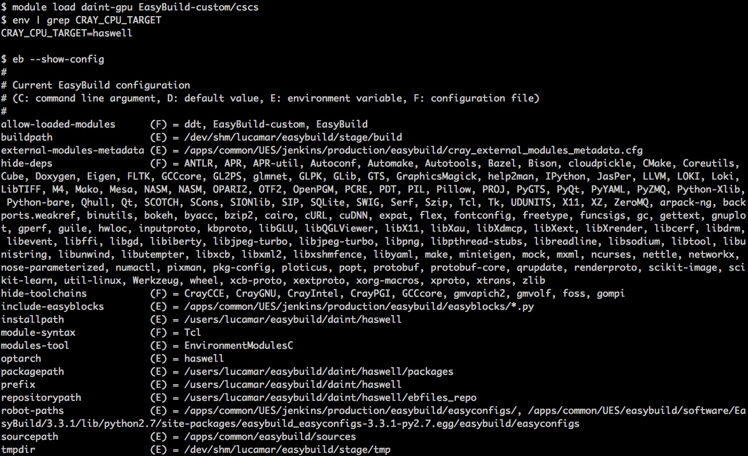
EasyBuild on Piz Daint: configuration
$ eb -h / -H (help screen)
CRAY_CPU_TARGET is defined as haswell when daint-gpu module is loaded
The EasyBuild-custom modulefile defines a set of environment variables:
EASYBUILD_PREFIX
This is the root folder for the modules that will be built within the session
EASYBUILD_ROBOT_PATHS It contains the folders where the EasyBuild engine will search for configuration files to build in this session

Slide 24
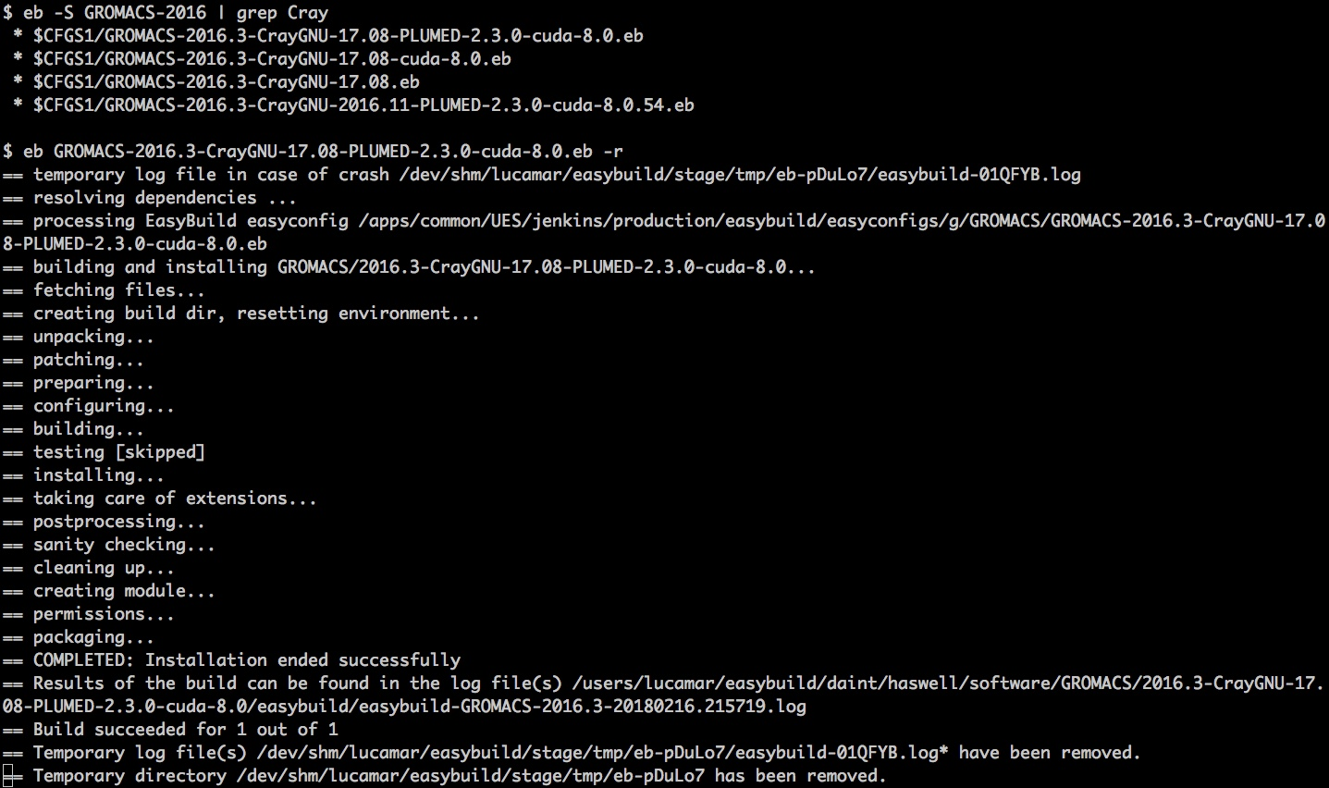
EasyBuild on Piz Daint: search and install local modules
We look for GROMACS and we filter the recipes built with a Cray toolchain
$ eb -S/--search <pattern>
We build resolving the dependencies the recipe providing GROMACS with the PLUMED plugin for MD
$ eb <file>.eb -r
The module is built under $HOME and can be loaded later after prepending the full path to the environment variable MODULEPATH:
$ module use <localpath>

Slide 25
EasyBuild on Piz Daint: tweaking existing easyconfig files locally
Modifying easyconfig files on the fly without manually creating all the input files using the --try-* options
We try to build the more recent GROMACS 2018 release from version 2016.3
The EasyBuild flag to use is
--try-software-version
EasyBuild will try resolving the dependencies with -r:
do not hard-code versions but use string templates:
--avail-easyconfig-templates
More details available at the link:
http://easybuild.readthedocs.io/en/latest/Writing_easyconfig_files.html

Slide 26
EasyBuild on Piz Daint: customizing existing recipes
In order to extend or customize an existing CSCS EasyBuild recipe, the first step will be to clone the CSCS production project from GitHub to create your own local private repository:
git clone https://github.com/eth-cscs/production.git
The command will download the repository under the newly created folder production
CSCS EasyBuild recipes are listed alphabetically in production/easybuild/easyconfigs
To use your local repository, you need to export this EasyBuild environment variable:
export EB_CUSTOM_REPOSITORY=<your_local_path>/production/easybuild
module load daint-gpu EasyBuild-custom

Slide 27
EasyBuild on Piz Daint: basic editing of existing recipes
The EasyBuild configuration files (easyconfigs) are plain text files in Python syntax
They define easyconfig parameters mostly using key-value assignments
Naming scheme: <name>-<version>[-<toolchain>][<versionsuffix>].eb
<toolchain> label matches the string Cray on Piz Daint (e.g.: CrayGNU-17.08, CrayIntel-17.08)
Optional <versionsuffix> label could contain CUDA or Python versions used to build the module
Filename important for automatic dependency resolution with -r/--robot (same toolchain by default)
Parameters: eb -a / --avail-easyconfig-params (default ConfigureMake or -e <block>)
software name, version, homepage, description for metadada and toolchain are compulsory
sources (filenames) and source urls for download are needed, patches can be provided too
dependencies (runtime) and builddependencies (build-only) allow resolution with -r/--robot
configure/make/install options can be provided defining configopts, buildopts and installopts
sanity_check_paths (files/directories installed) and sanity_check_commands (simple tests)
a generic easyblock is enough in many cases (ConfigureMake, CMakeMake: eb --list-easyblocks)
For the details please check http://easybuild.readthedocs.io/en/latest/Writing_easyconfig_files.html

Slide 28
EasyBuild on Piz Daint: example easyconfig file
The GROMACS recipe file is based on the CSCS template:
version becomes custom
absolute path in sources
Please note that EasyBuild expects a build folder called <name>-<version>
Therefore please make sure to package your custom source tarball accordingly
We keep the dependencies and other options unchanged for this custom version which modifies only the source files

Slide 29
EasyBuild on Piz Daint: building a custom modulefile locally
We can proceed building the modulefile as usual:
we did not change the dependencies, so we can skip the option -r
after a successful build the local modulefile GROMACS/custom-… will be listed by the command module avail
add the local module installation path to your MODULEPATH to have the module later as well:
$ module use <localpath>

Slide 30
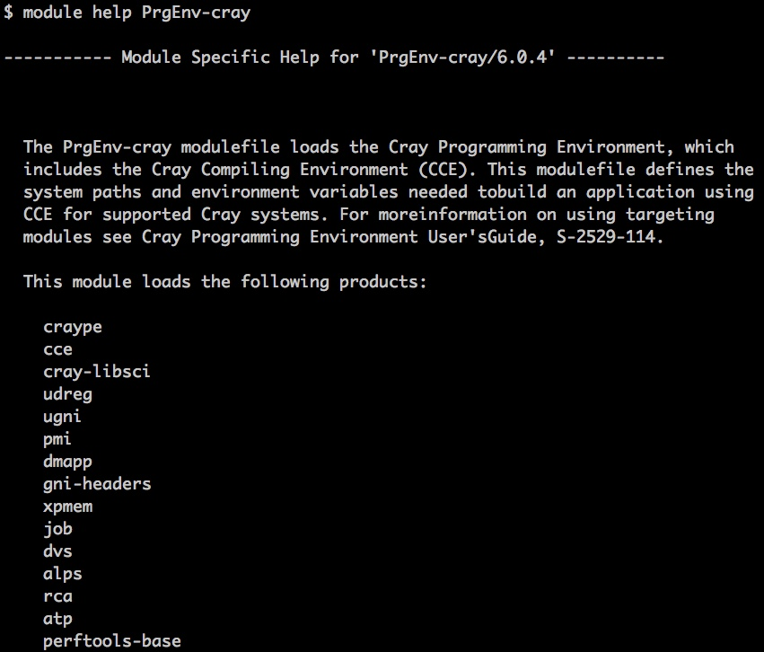
Documentation
Manuals and User’s Guides on Cray PE are addressed by CrayPubs, man or module help
Further details can be retrieved selecting specific modules of the Cray PE with module help:
module help cce
The CSCS User Portal at http://user.cscs.ch gives basic information on how to compile your code on Cray systems under the section Scientific Computing:
Code Compilation

Slide 31
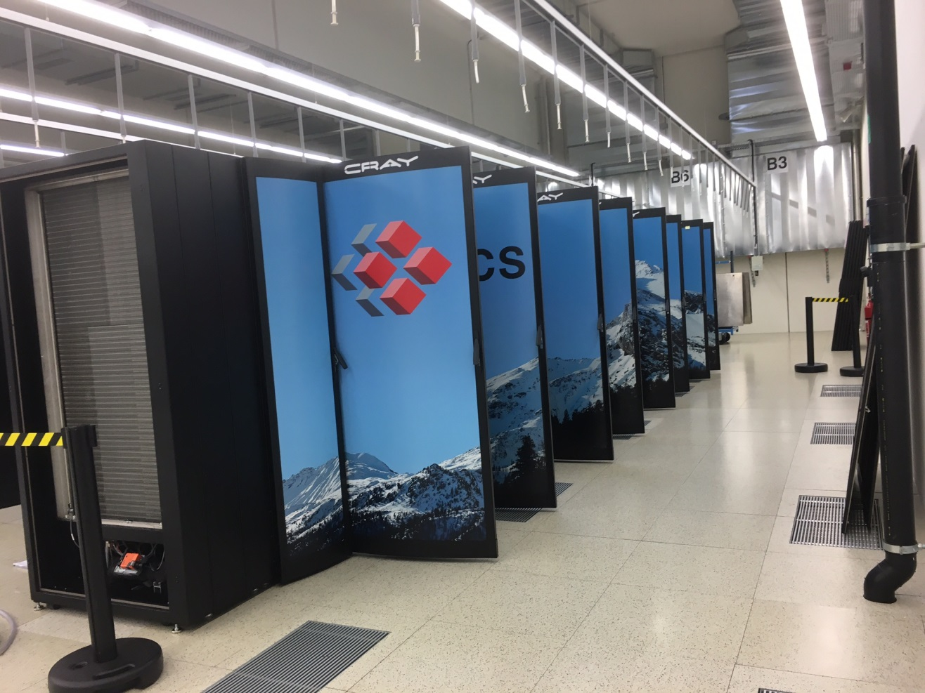
Further information
CSCS User Portal:
http://user.cscs.ch
Cray Documentation:
https://pubs.cray.com
NVIDIA Documentation:
http://docs.nvidia.com
Contact us:
help@cscs.ch
Piz Daint in the machine room at CSCS

Slide 32
Thank you for your kind attention

